Slide 1

Minor Project Presentation “GO AGRO”
Under the guidance of Dr. Avani Sharma
Department of Information Technology
School of Computing and Information Technology
Manipal University Jaipur
Jaipur, Rajasthan

Slide 2
Table of Contents
Project Objectives
Introduction
Background Details
System Design & Methodology
Implementation and Results
Conclusion
References

Slide 3
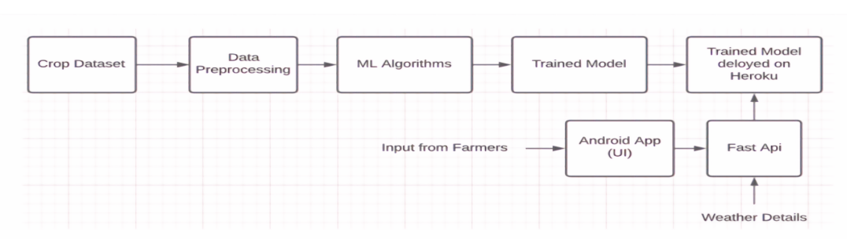
Project Objectives
Crop Recommendation - Our ML model predicts the most suitable crop for farmers by analyzing various parameters such as soil quality, climatic conditions, and historical crop yield data.
Fertilizer Recommendation - Our ML model uses various parameters to provide farmers with personalized suggestions to manage nutrient levels in the soil. By analyzing factors such as soil quality, crop type, and historical data, the model offers recommendations for fertilizer usage and soil management practices.
Crop Disease Classification - Our ML model utilizes image recognition technology to classify plant diseases based on input images provided by farmers. By analyzing the image, the model identifies the disease and explains why it has occurred in the plant. Additionally, the model provides personalized remedies to cure the plant, based on the disease identified and other environmental factors.

Slide 4
Introduction
To aid farmers in making informed decisions about farm management and agribusiness activities, a web application will be developed that employs a combination of recommender systems and machine learning. This research involves utilizing machine learning algorithms to identify crop conditions, detect diseases, make crop predictions, and provide recommendations. The study aims to demonstrate how a recommender system can be utilized in agriculture to identify and predict crop diseases.
The web application comprises three modules, namely crop recommendation, fertilizer recommendation, and plant disease classification. The crop recommendation module utilizes a Random Forest machine learning algorithm to suggest suitable crops based on various parameters such as soil NPK levels, pH value, and rainfall in the area. The fertilizer recommendation module provides suggestions on improving soil fertility, while the plant disease classification module aids farmers in identifying diseases by analyzing input images of plant leaves.

Slide 5
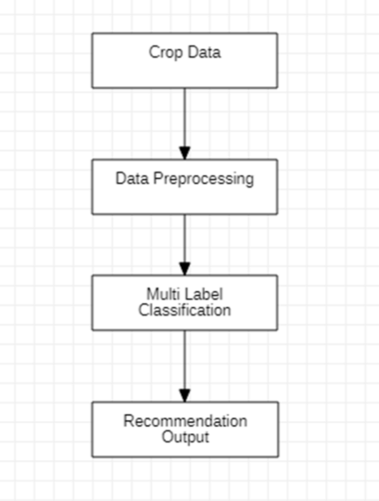
Background Details
The study utilized the random forest algorithm to predict agricultural yield and determine product cost based on temporal data. The proposed system was evaluated using a static dataset and applied to a small area. By analyzing weather data, the system suggested appropriate crops for farmers to grow in specific soil and climate conditions.
Our web application offers a crop recommendation system that utilizes algorithms such as Random Forest, Naive Bayes, and K nearest neighbor to suggest suitable crops for the available soil. Precision farming, also known as digital farming, is becoming increasingly important in agriculture as it involves the use of hi-tech computer systems to calculate various parameters such as weed detection, crop prediction, yield detection, crop quality, and other machine learning farming techniques.

Slide 6
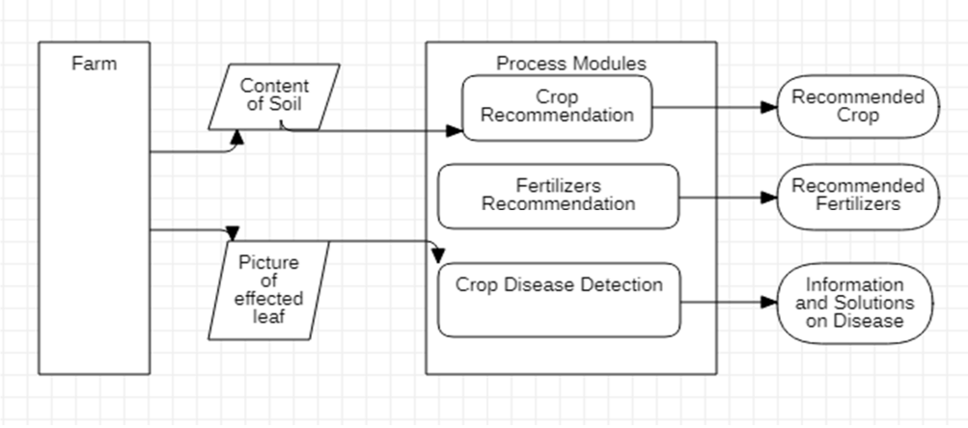
System Design & Methodology
Crop Recommendation: This module considers the soil composition and predicts the most suitable crop to be grown.
Fertilizers Recommendation: This module analyzes the soil content and suggests the type of fertilizers that are required to improve the fertility of the soil in your farm.
Crop Disease Detection: This module requires an image of an affected leaf and processes it to provide information about the type of crop disease and possible solutions to it.
Systems Architecture

Slide 7
For Machine Learning and deep learning, we use algorithm as follow:
KNN - (K Nearest Neighbors): The K-NN algorithm is a non-parametric method used for predicting class membership. First, the algorithm identifies the k nearest neighbor for each incoming instance.
Random – Forest: The Random-Forest method is an ensemble learning technique used for both classification and regression tasks. To utilize this algorithm for prediction, the test features must be passed through the rules of each randomly created tree.
Decision – Tree: A decision tree is a type of machine learning algorithm that falls under the category of supervised learning. In this algorithm, the attributes and class labels are represented using a tree structure.
Neural – Network Neural network systems use connected nodes called neurons to improve their performance by learning from examples. Signals are transmitted between neurons via connections, each of which has an associated weight that is updated and adjusted during the learning process.
Conventional Neural Network (CNN): A Convolutional Neural Network, also known as a ConvNet or CNN, is a type of Deep Learning algorithm that can analyze input images by assigning significance to different objects or features within the image through learnable weights and biases.

Slide 8
Dataset
In any Machine Learning System, data plays a crucial role. To achieve a good harvest, certain parameters such as temperature, humidity, soil pH, sunlight, and soil moisture must be met for healthy plant growth. However, these conditions may vary depending on the plant variety. To predict the crops, datasets from various sources such as government websites and Kaggle were utilized. The dataset used for crop recommendation includes 22 crops grown in India, and the parameters considered are nitrogen, phosphorus, potassium, rainfall, temperature, humidity, and pH. For crop disease classification, the dataset includes images of leaves from 14 plants with 26 types of images displaying a particular disease in a plant, excluding healthy leaves. Each plant disease type consists of 1800 images.
Data Exploration
Data exploration involves analyzing and understanding the relationships and patterns within a dataset. One common technique for identifying correlations between columns in a dataset is by using a heatmap to visualize the correlation matrix. The correlation matrix is calculated using statistical measures like Pearson Correlation and is then represented visually as a heatmap. This helps in identifying any significant correlations or patterns within the data and can be used to gain insights into the underlying factors influencing the dataset.

Slide 9
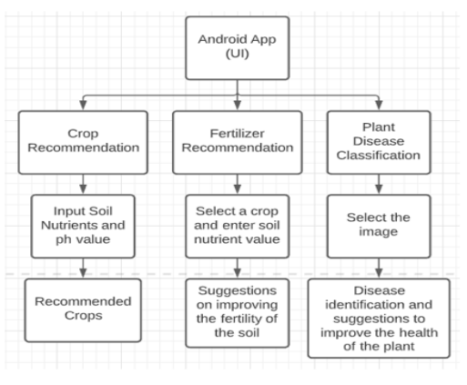
Interface
It shows the system architecture of our proposed model. It is a web app that consists of three modules- crop recommendation, fertilizer recommendation, and plant disease classification. The crop recommendation module recommends the crop based on the values of the different parameters given by the user. The fertilizer recommendation module suggests how to improve the fertility of the soil. The plant disease classification module helps the farmer to identify the disease.

Slide 10
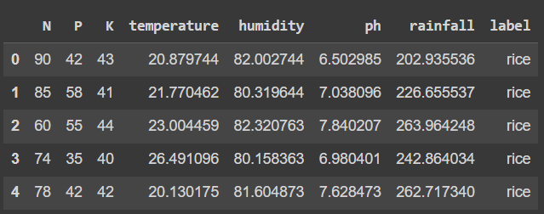
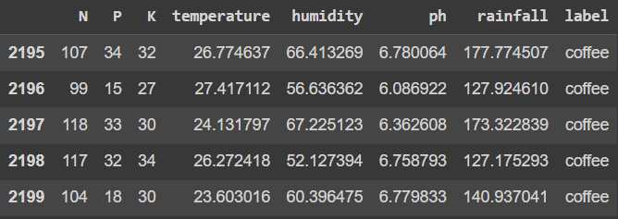
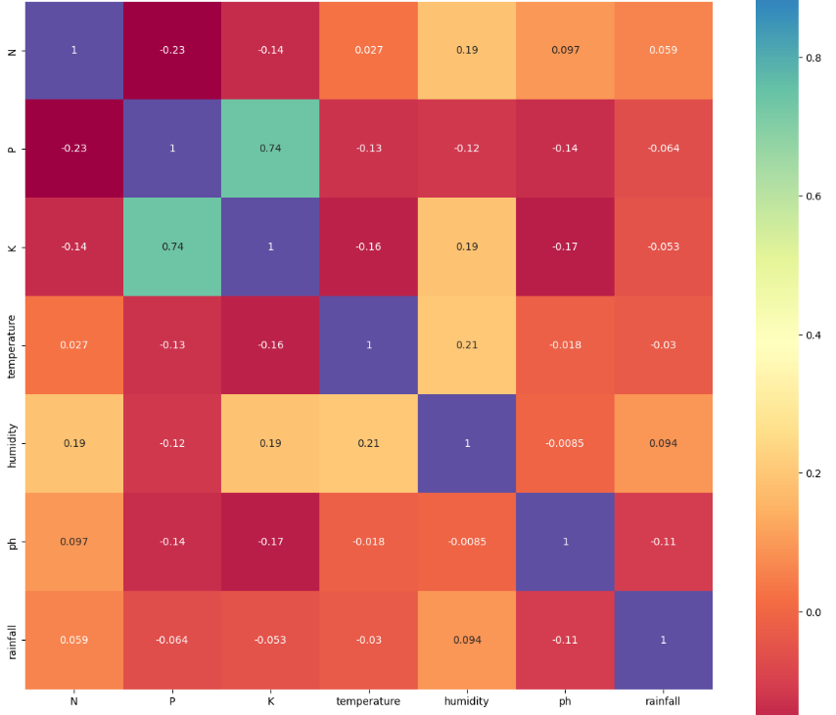
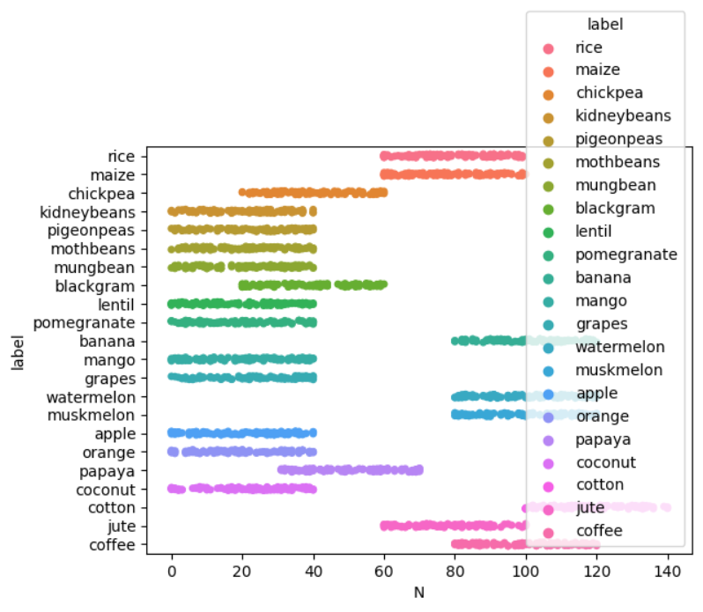
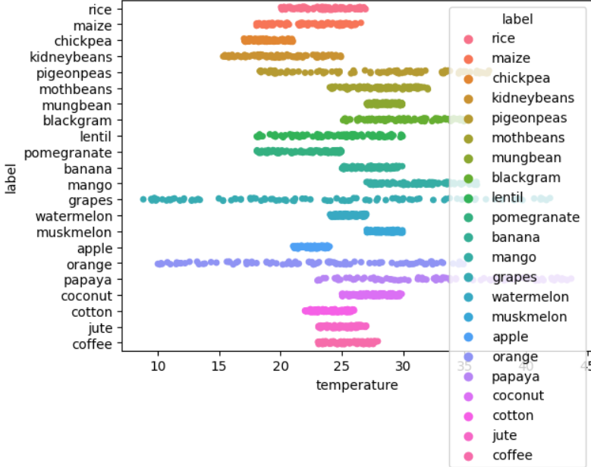
Implementation and Results
Crop Recommendation System
Dataset
Data Exploration

Slide 11
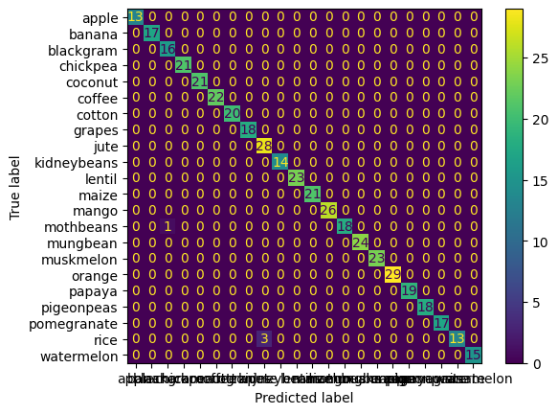
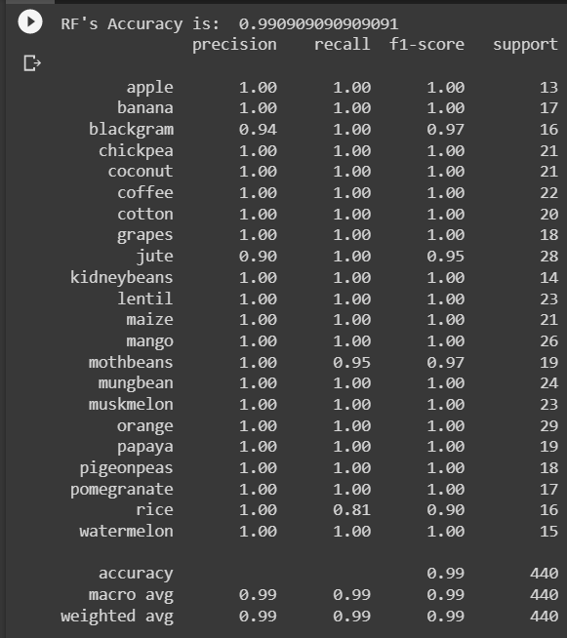
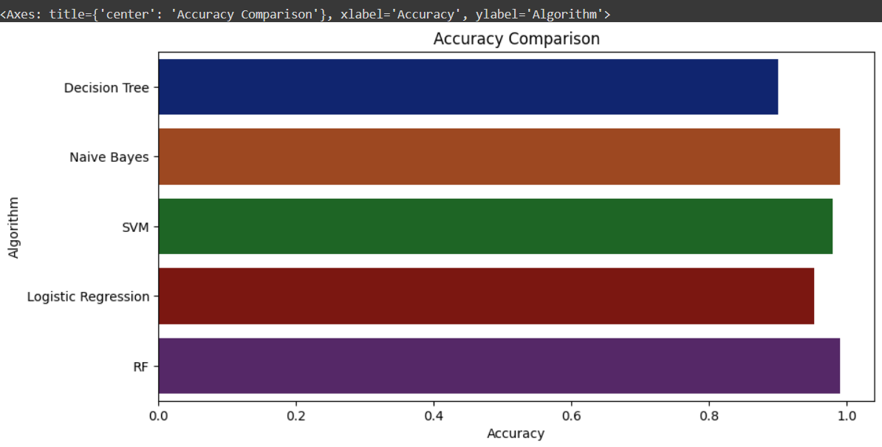
Output
Confusion Matrix Classification Report
Model Comparison

Slide 12
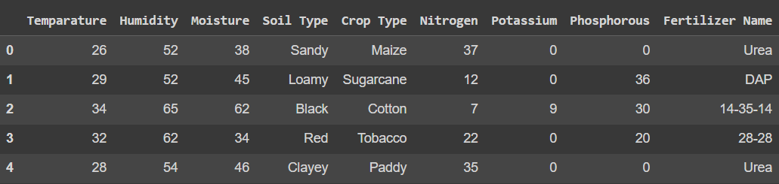
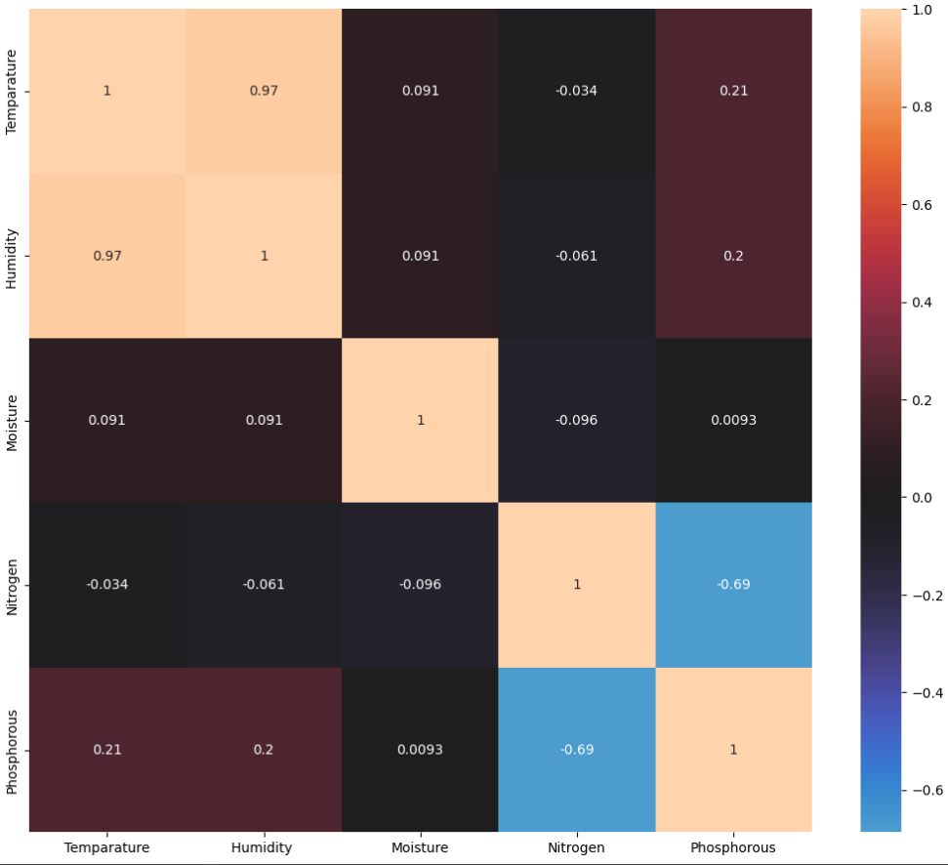
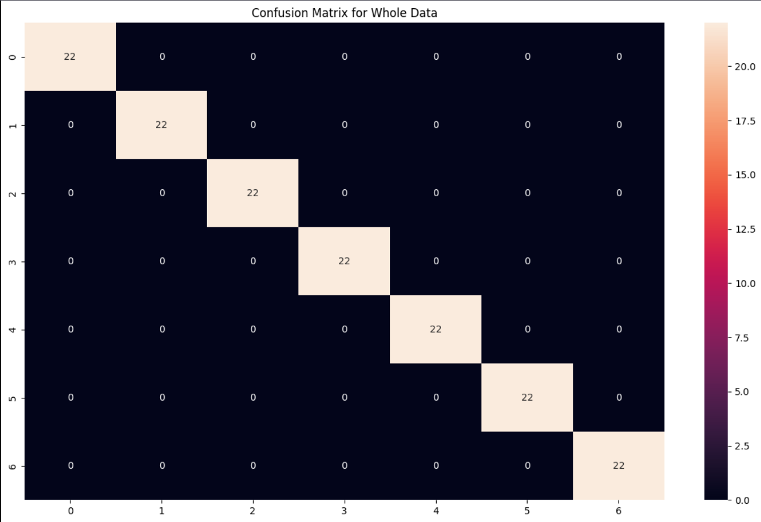
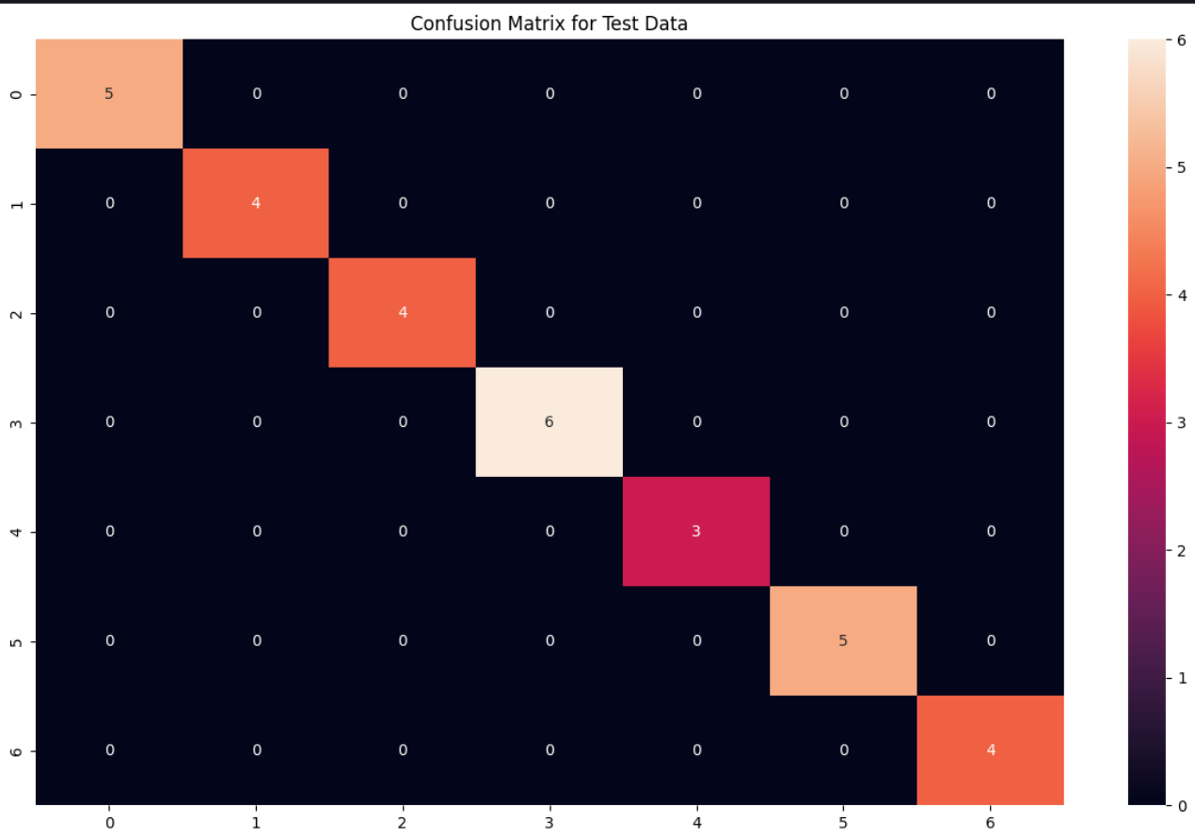
Fertilizer Recommendation System
Dataset
Data Exploration

Slide 13
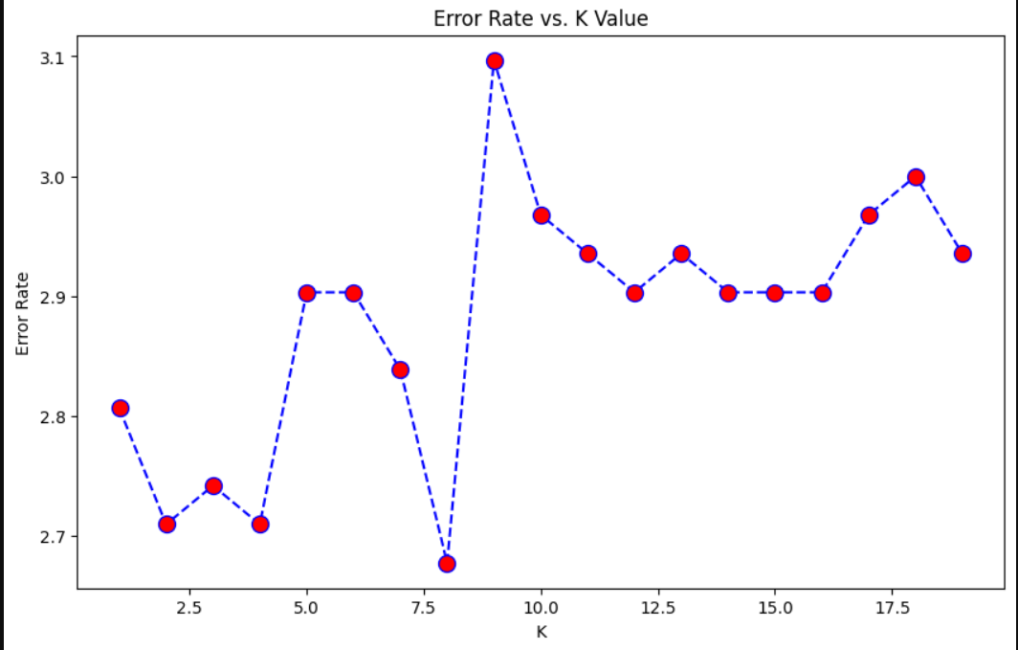
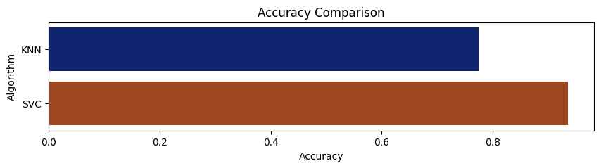
Results
KNN Error Rate
Model Comparison

Slide 14
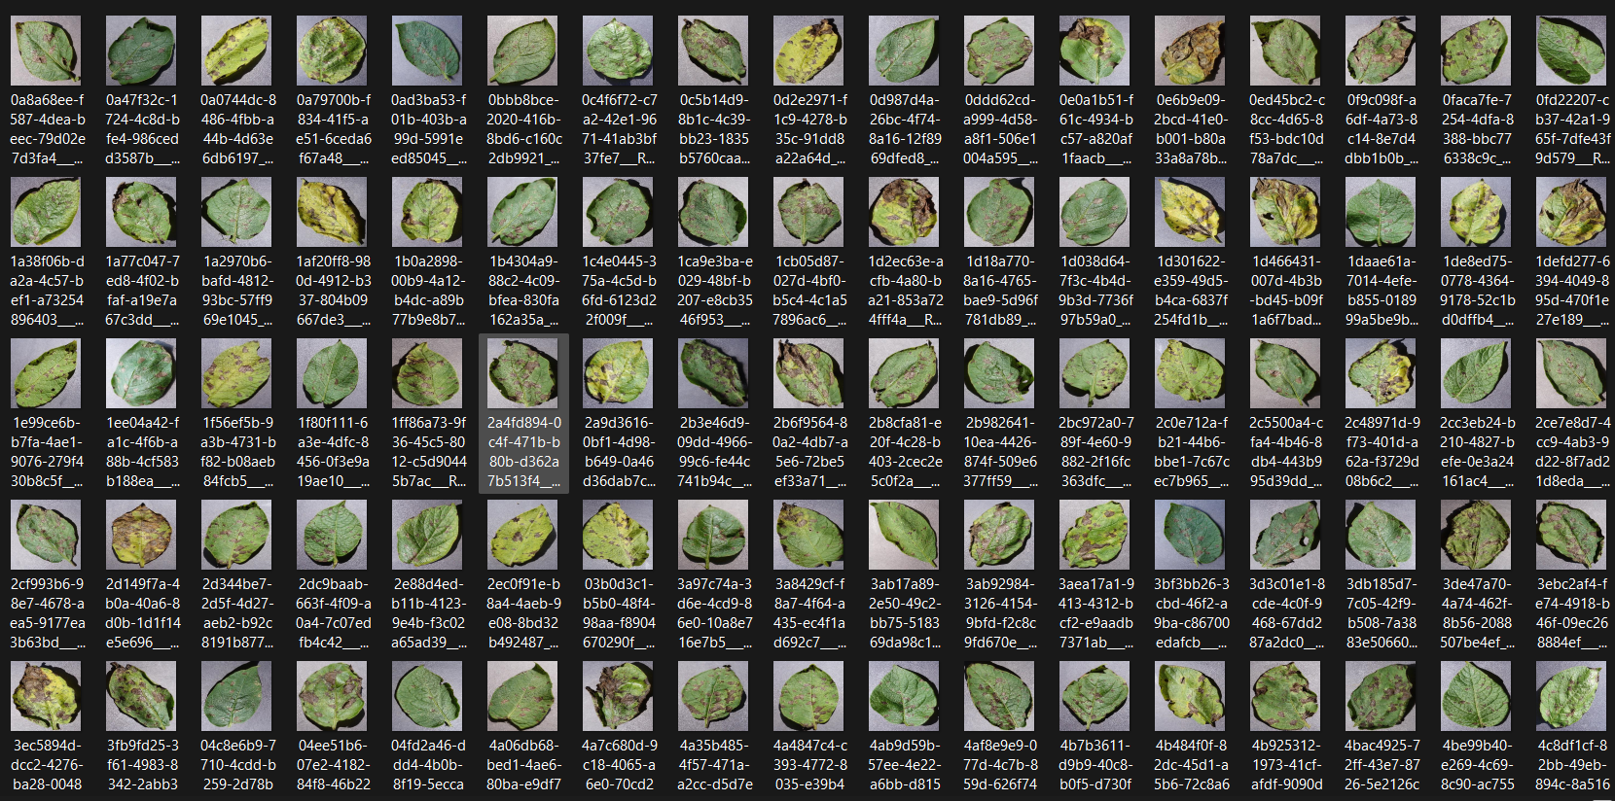
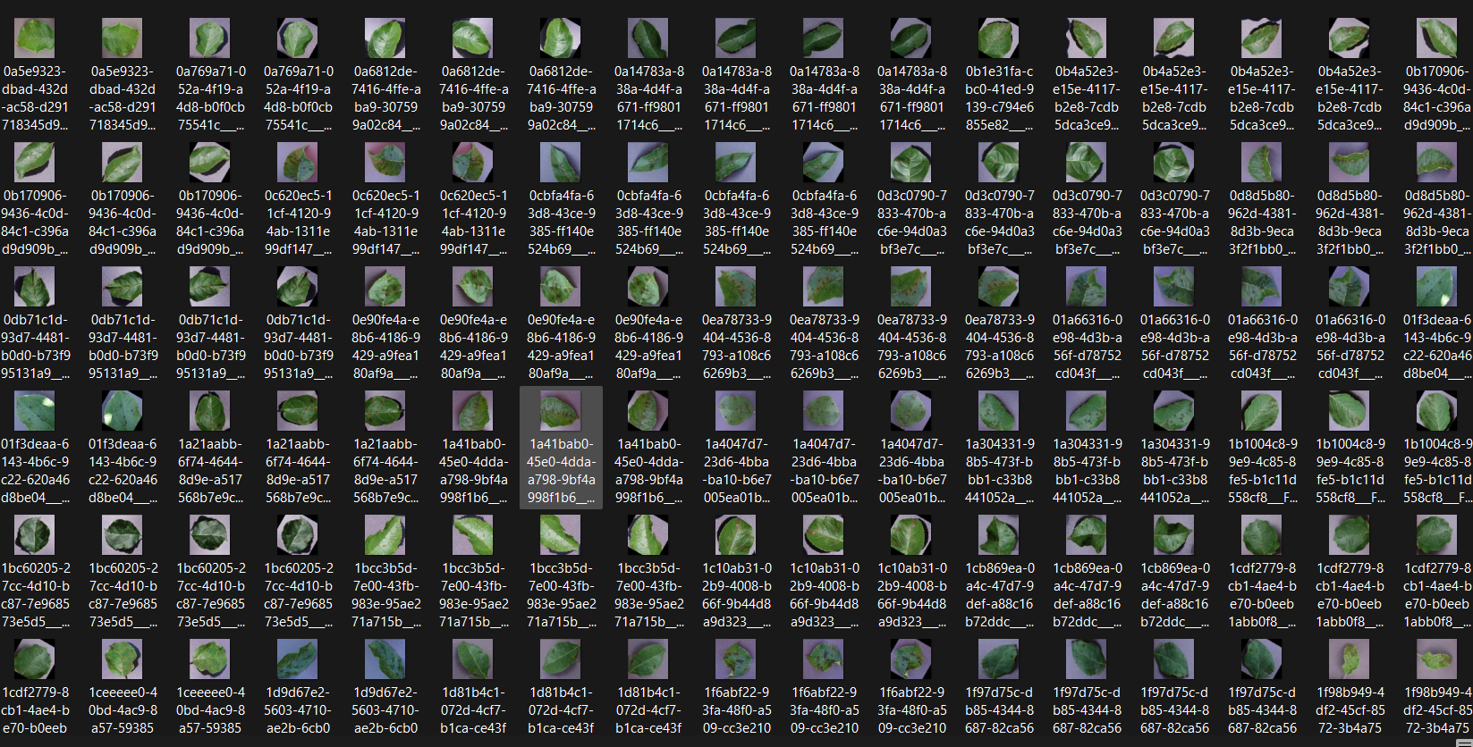
Disease Detection System
Dataset

Slide 15
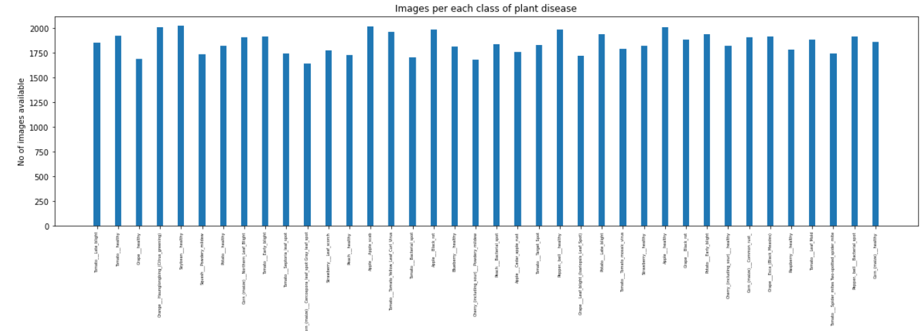
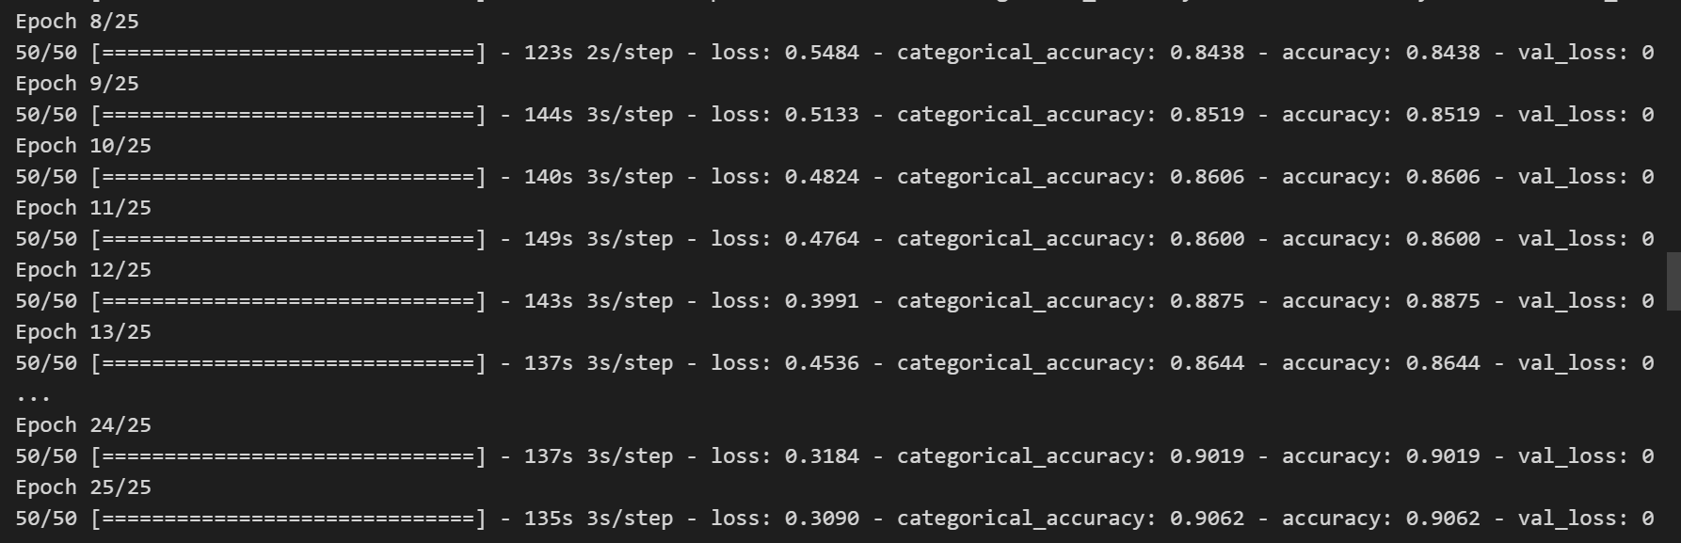
Dataset (No. of Images)
Epochs and Steps/Epochs

Slide 16
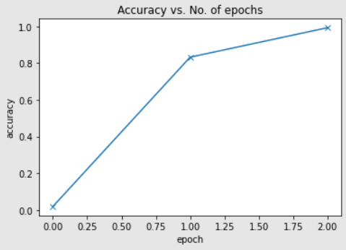
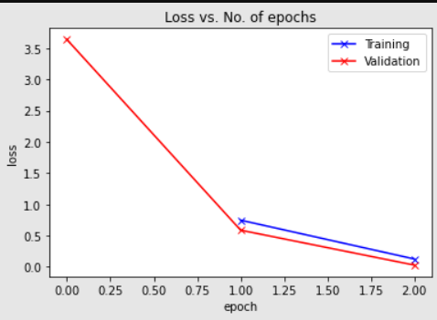
Results
Accuracy Rate Loss Rate

Slide 17
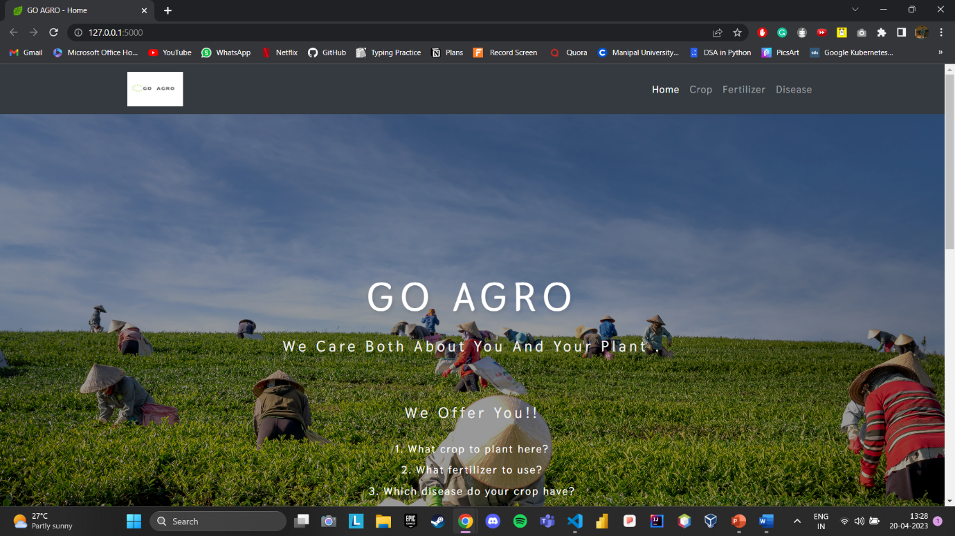
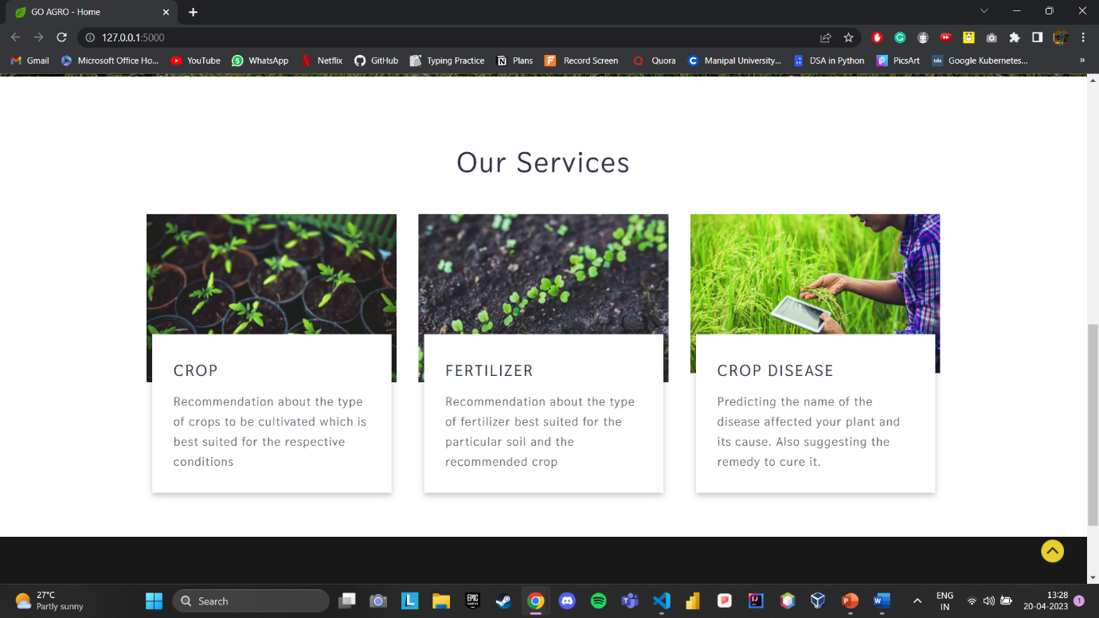
WebApp Interface (Frontend)

Slide 18
Conclusion
This approach can help to create a comprehensive system for the farmers, which will not only help them with crop selection but also provide them with a complete solution for their agricultural needs. With the integration of yield prediction, the farmers can also predict the expected yield and plan their resources accordingly. Additionally, by including more data and pictures of infected plants, the accuracy of the disease detection system can also be improved, which will help the farmers to take timely action and prevent crop losses. This system can also be extended to include weather predictions and pest control recommendations to provide a complete agricultural solution to the farmers. Overall, the use of technology and analytics can revolutionize the agricultural sector and help the farmers to increase their income and contribute to the growth of the economy.
Our project offers a smart crop recommendation system and fertilizer recommendation system that is designed to be accessible and useful for farmers throughout India. With this system, farmers can make informed decisions about which crops to grow and how to best use fertilizers to maximize their yields. Additionally, we have developed a separate module for crop disease detection, which uses textural analysis of leaves to predict the type of disease affecting the crops. This approach provides farmers with a valuable tool for identifying and addressing potential crop diseases before they can cause significant damage.

Slide 19
References
The following resources would be used to gain knowledge about the topic-
• Ensemble Methods - a collection of machine learning techniques that use multiple models to improve performance. Link: https://scikit-learn.org/stable/modules/ensemble
• ResNet-9 - a deep convolutional neural network architecture with nine layers and skip connections. Link: https://www.researchgate.net/figure/ResNet-9-architecture-A-convolutional-neural-net-with-9-layers-and-skip- connections_fig1_363585139
• Recommendation System - a system that provides personalized suggestions based on user preferences and behaviour. Link: https://towardsdatascience.com/recommendation-systems-a-review-d4592b6caf4b
• Deployment - the process of making a software application available to users. Link: https://www.geeksforgeeks.org/deploy-python-flask-app-on-heroku/
• JetIR - a journal of engineering and technology research. Link: https://www.jetir.org/papers/JETIRAU06049
• Stackoverflow - a community-driven question and answer website for programming-related topics. Link: https://stackoverflow.com/
• Detection - the process of identifying objects or patterns within an image or video. Link: https://towardsdatascience.com/implementing-real-time-object-detection-system-using-pytorch-and-opencv-70bac41148f7
• Research Paper - a scholarly article that presents original research or analysis. Link: https://paperswithcode.com/task/real-time-object-detection
• Computer Vision - a field of study focused on enabling machines to interpret and understand visual data. Link: https://docs.opencv.org/4.x/
• Globalaveragepooling2d - a layer in Keras that computes the average value of each feature map in a convolutional neural network. Link: https://www.tensorflow.org/api_docs/python/tf/keras/layers/GlobalAveragePooling2D

Slide 20
THANKYOU!

